Slide 1

Hello World

Slide 2
What is Programming
Programming is the act of instructing computers to carry out tasks - It is often referred to as coding
What is a computer program: A computer program is a sequence of instructions that the computer executes.
Analogies of Programming
Programmer vs. Developer
Office vs. Freelance
Ex: Digitalisation of any problem that was previously done by hand / Excel

Slide 3



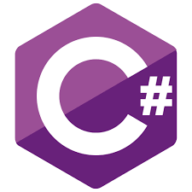







Slide 4

Software Platforms
Desktop - Windows, Linux, IBM, macOS, Solaris, …
Mobile - Android, iOS, BlackBerry, Symbian, Windows Phone, …
WEB

Slide 5
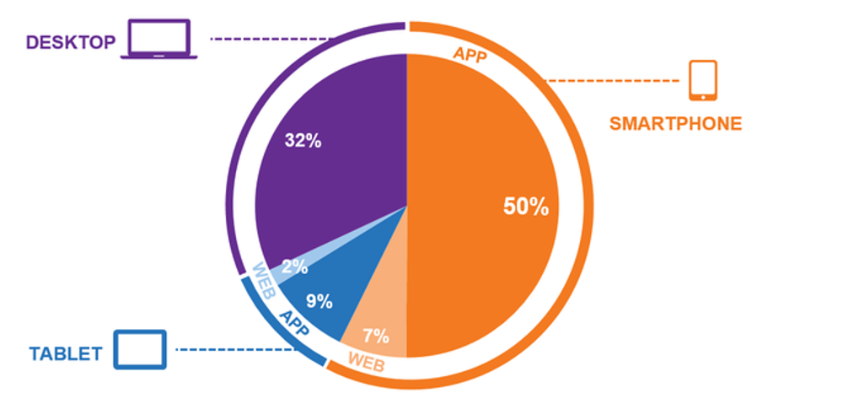

Slide 6
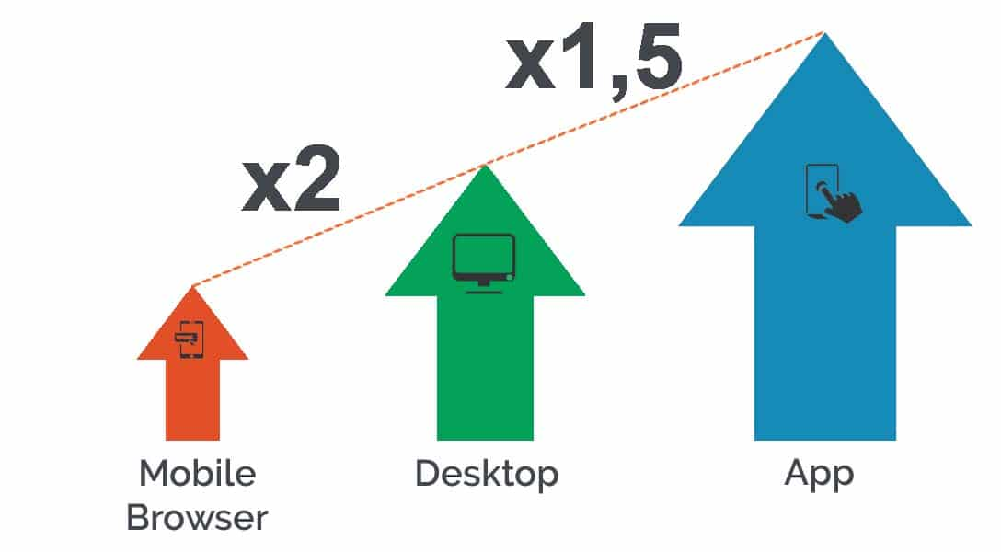

Slide 7
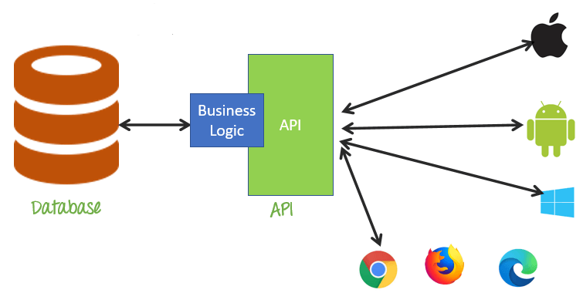

Slide 8
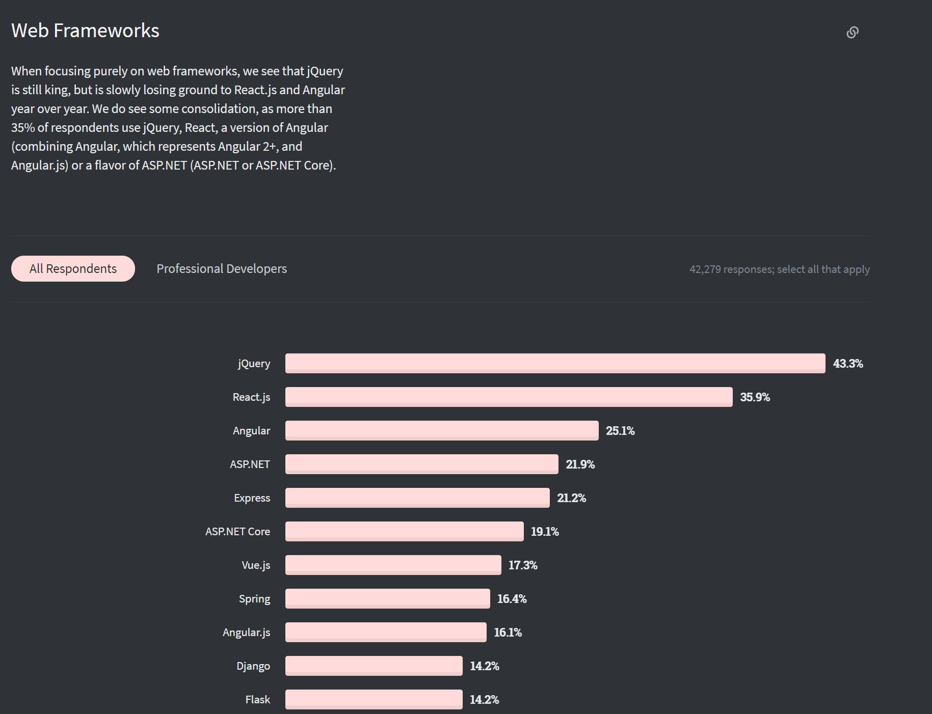
https://insights.stackoverflow.com/survey/2020

Slide 9
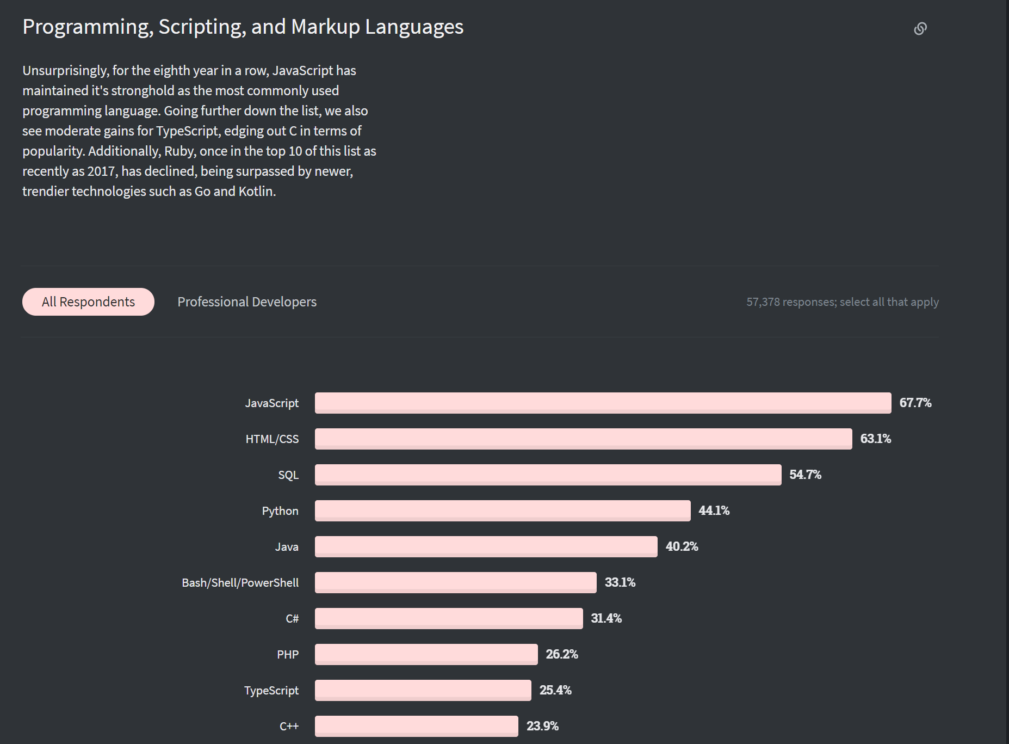
https://insights.stackoverflow.com/survey/2020

Slide 10
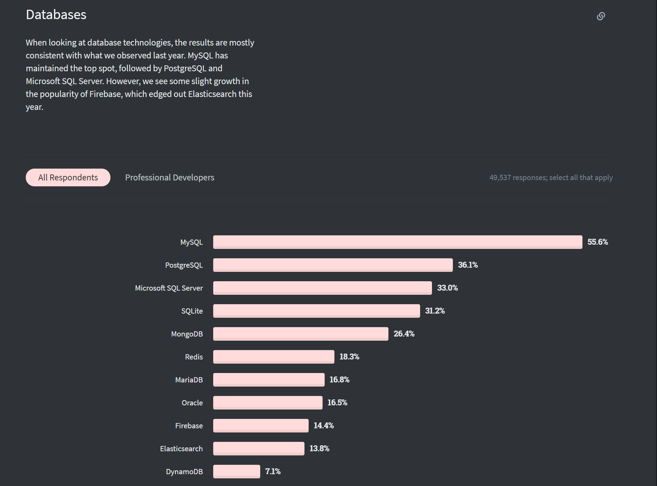
https://insights.stackoverflow.com/survey/2020

Slide 11
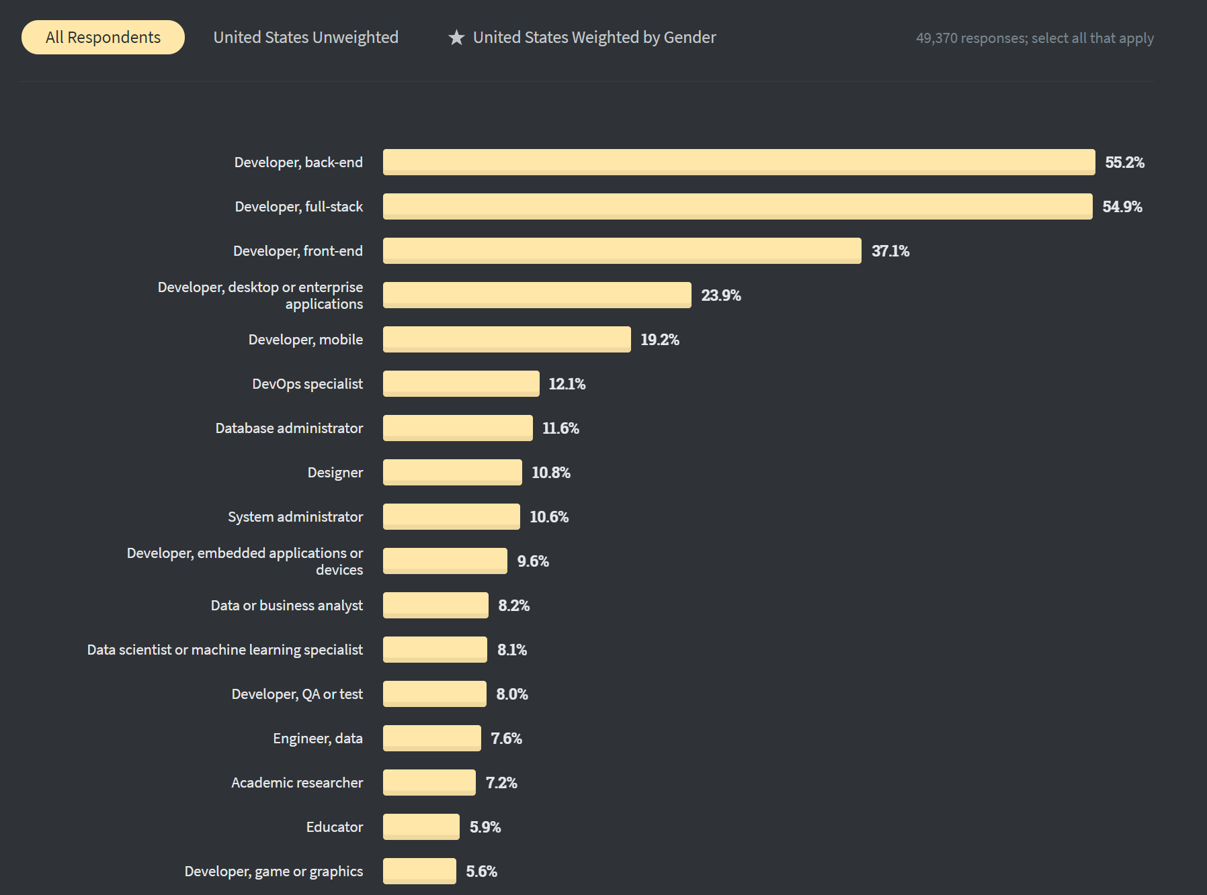
https://insights.stackoverflow.com/survey/2020

Slide 12
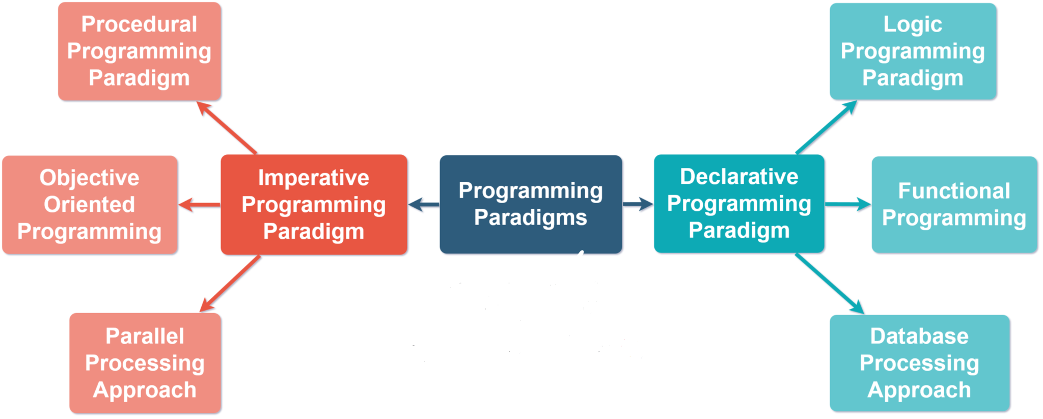
Notes:
https://mvthanoshan.medium.com/different-programming-paradigms-69eb8643c728
https://www.geeksforgeeks.org/introduction-of-programming-paradigms/

Slide 13
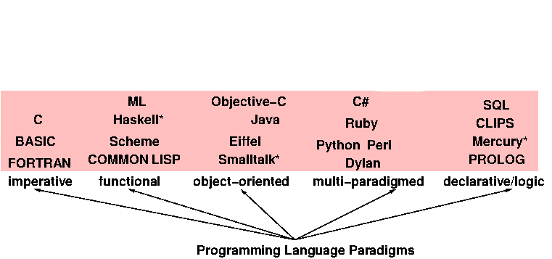
Programming Language Paradigm
Notes:
By Our Audience we mean: describe the typical demographics in the classrooms like we have everyone from age 15 till 40+, boys and girls, working and students, etc. THis program is designed for everyone

Slide 14
Programming Language Paradigm
Imperative in which the programmer instructs the machine how to change its state,
Procedural which groups instructions into procedures,
Object-oriented which groups instructions together with the part of the state they operate on,
Declarative in which the programmer merely declares properties of the desired result, but not how to compute it
Functional in which the desired result is declared as the value of a series of function applications,
Logic in which the desired result is declared as the answer to a question about a system of facts and rules,
Mathematical in which the desired result is declared as the solution of an optimization problem

Slide 15
Thanks!

